Slide 1
Ethics Case Study
By: Caffeine Overflow
Notes:
Good afternoon everyone, I am Dante Beltran, Team lead for Caffeine Overflow. I am joined by Hamza, Kevin, Mark and Bochi, and today we are going to be talking about the ethics case study that we chose to research. Now, let us get started.

Slide 2


Case Study 2
Notes:
I will now hand it off to (Kevin) so that he can talk about the case study we selected.

Slide 3

CASE STUDY 2
Your supervisor is comfortable in their position.
Your Supervisor's manager is thinking of firing him
Offers you his position as a result.
Notes:
Thanks, Dante.
The case study we chose to research was “case study 2” to start, I will briefly explain the case study:
You neither like nor dislike your supervisor but they have become quite comfortable in their position and productivity of the team has dropped. Your supervisor’s supervisor approaches you, tells you in confidence that they are thinking of firing your supervisor in a month if productivity does not return to previous levels. They ask you if you would be interested in the position, and to let them know in a day or two. You know that you can do the job and the salary increase would be nice, but you are not sure if you should do it.

Slide 4

Dilemma
Notes:
I will now pass it on to Mark to talk about the Dilemma.

Slide 5
THE DILEMMA
Conflict of Respect
Has your supervisor been made aware of potential problems with productivity in the team?
Conflict of Fairness & Justice
Is this potential new position being offered in a fair way, which is open to other applicants?
Conflict of Trustworthiness
Do you present this information to your direct supervisor, or keep this to yourself?
Conflict of Caring
Do you make an unethical decision that ultimately benefits the department?
Is your direct supervisor being terminated in an ethical way?
Notes:
Your supervisor’s supervisor has crossed a line professionally by telling you about disciplinary action about to take place within the department about another employee. This is information that you really should not know about and invades the privacy of your direct supervisor, especially if they don’t know that disciplinary action is coming yet. This also calls into question how your direct supervisor is being fired. If they have not been given warnings about a dip in theirs and the team’s performance, it also brings up a conflict of fairness, for they cannot fix any of their issues or improve their performance if they are not aware of any to begin with. As well, the issue of fairness also relates to how this position is being replaced. This position is only being offered to you and no one else in the department, and your supervisor’s supervisor is not following the proper protocol of replacing your supervisor by making a public positing for everyone to apply to.
There is also a dilemma about trustworthiness. Your supervisor’s supervisor told you this information in confidence, expecting you to keep the details to yourself. If you were to warn your supervisor or report your supervisor’s supervisor to HR, you would be breaking their trust and opening yourself to disciplinary action or retribution potentially. Even if you were to tell your supervisor of what’s coming, they may not believe you or process your information as insubordinate.
Finally, there is a conflict of caring. You and your supervisor’s supervisor both care about your job and the performance of the department, and you want to see the department perform at its best. However, this could mean getting rid of your direct supervisor in favor of improving the department’s performance, by taking leadership yourself, but at a highly unethical cost.

Slide 6

Stakeholders
Notes:
I will now pass it on the Dante to talk about the Stakeholders.

Slide 7





KEY STAKEHOLDERS
You/Family
Your supervisor
Your supervisor's manager
Co-workers of the Department
Notes:
The first key stakeholder would be yourself and your family. With this specific case study, you and your family are directly impacted. This is because the possibility of a promotion will increase your pay and increase your responsibilities. Which in turn could put more money in your pocket for you and your family, however the increase of responsibility may cause you to spend less time with your family.
The second key stakeholder would be your supervisor. Your supervisor's job is on the line here. If he were to lose his job, this will negatively affect his career and life in a tremendous way.
The third key stake holder would be your supervisor’s supervisor. They are vital to this case study because they will be the one to makes the decision to fire your supervisor and promote you.
Lastly are the co-workers of the department. An important note is that your supervisor is also their supervisor, and it is important to consider that firing a supervisor can affect everyone that works there as well. Depending on each coworker's relationship with the supervisor that was fired. That could spark more employees to quit out of frustration. Especially if the co-worker had a great relationship with the supervisor.

Slide 8


Notes:
Now it is time for a quick game of Kahoot. We have Identified four key alternatives that we are going to consider for this case study and would like the class to participate in a Kahoot game to see what all of you would select as your desired alternative.

Slide 9

Alternatives
Notes:
Thanks everyone for participating in the Kahoot, I will now hand it off to Hamza so he can dive into each alternative we selected.

Slide 10
Alternatives
Number 1
Warn supervisor about the managers concerns, decline the offer for his position.
Do not warn supervisor, decline the offer.
Number 2
Warn supervisor, accept the offer.
Number 3
Do not warn supervisor, accept the offer.
Number 4
Notes:
Thanks Dante,
For the alternatives, we have selected four options that can be considered a solution to the conflict, let's get right into it.

Slide 11

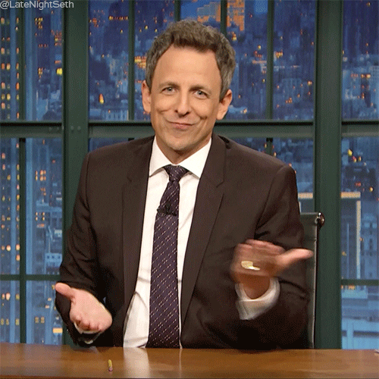

Warn supervisor, decline the offer
Pros
Resolve issue, save supervisors job
Strengthen relationship with supervisor
Better reputation with supervisor/team
Cons
Offend supervisor
Cause issues with supervisor's supervisor
Risk current position
Breach of privacy
Notes:
Alternative #1: Warn Supervisor about managers concerns, decline the offer for his position.
Now, with this approach, there is a few factors that you must consider. Number one, what is your relationship with your manager like. Are you close with your manager? How is he going to react to you telling him this? How will it affect you?
This can go a few ways. If you are close to your manager and can communicate this information to him in a helpful way, without him being offended, you can help your manager get back on track and make sure all the issues that upper management had are resolved. This can be good as it will strengthen your relationship with your immediate manager and help better your reputation with him.
On the other hand, this decision can turn out to be catastrophic for yourself. If you confront your manager with this information. He might be offended by this information coming from someone who ranks lower than him in the company hierarchy and may confront upper management. This then jeopardizes your position in the company as upper management can easily deny these claims which puts you in a tough spot with not only your manager, but also upper management. Your manager may not want you on their team anymore and upper management may act against you for breaking their confidence.
Based on this, we really must analyze the possible outcomes and consequences of this alternative. We know that if we inform our manager, it CAN be helpful to everyone involved as it protects everyone's careers while also making yourself look good to your manager, but we also know that it can turn out bad for you. So, in this situation, you must analyze all the possible factors and figure out what works best for you.
TRANSITION: Next I will let Bochi explain another alternative.

Slide 12
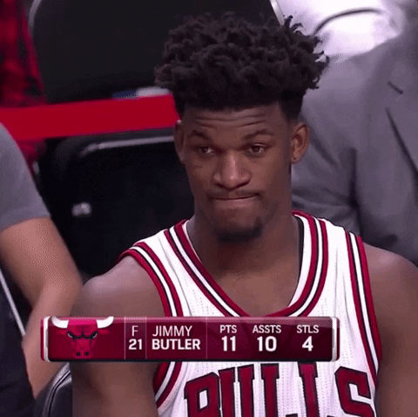
Warn supervisor, accept the offer
Pros
Clarify issue
Promotion potential
Beneficial
Cons
Misleading action
Unethical solution
Possible serious investigations / Job loss
Notes:
We chose this as one of our alternatives because it keeps everyone's best interest in mind. By informing the supervisor you make sure that he is aware of the situation, and he can adapt his work ethic to protect his job/career. Additionally, you make sure that in the case your manager does not step up his work quality to the required level, you get a promotion.
Now there are some things that can go wrong. If you inform your manager that he is not doing his job well, without providing any context or background as to why you are bringing it up, chances are, your manager will not be happy. This could endanger your current position as your manager can take action against you for questioning his work. Additionally, if your manager does find out that you went behind his back and accepted the job offer, this can lead to serious issues in the company if he decides to report you/the company management to HR which could then lead to further investigations regarding the situation subsequently putting you at risk. In which case, you might not get your supervisors position and potentially lose your current job.
So, although, on paper this sounds like a good solution, it may end up being more damaging than it seems.
TRANSITION: Now I will let Kevin explain the next one.

Slide 13
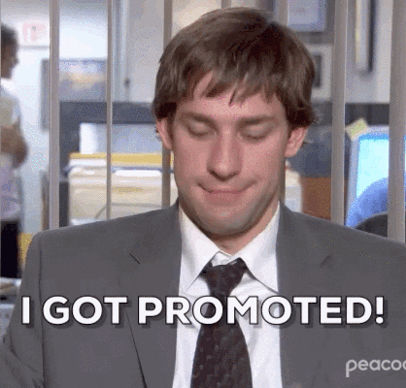
Do not warn supervisor, accept the offer
Pros
Get a better position
Better work quality from team
Management is happy
Cons
Conflicts among colleagues
Performance loss / Position replacement
Poor reputation / Growth limitation
Notes:
Alternative #3: You do not warn the supervisor and accept the offer.
This alternative focuses on your best interests. The company's upper management reached out to you because they think that you are qualified and would be a good fit for the position. This can be beneficial to you as well because you get a higher position as well as better compensation for the job. However, there is some things that you still have to consider: How is this going to affect you? How is it going to affect your work relationships? How will this impact your immediate manager?
In an Ideal world, you get the job. Everyone in the team is happy with this change and the expectations of the company management are met. However, this may not be the case.
There is a very real possibility that the team is not happy about this change and do not appreciate how you ended up in this position. This can cause many conflicts between the team and in return put you in the same situation as what your supervisor was in, in which case your career is at risk. Secondly, you, yourself might not like the position and the extra responsibility that comes with being a supervisor. There is also the possibility that your supervisor is not compensated for his termination, which could put him and his family in a very tough position. Another factor that you have to consider is that people in the company may develop a bad reputation of you and could limit your growth in that company. To top it all off, you need to go into the position understanding that if your manager can be replaced then so can you.
I will now pass it off to Hamza to talk about the last alternative.

Slide 14
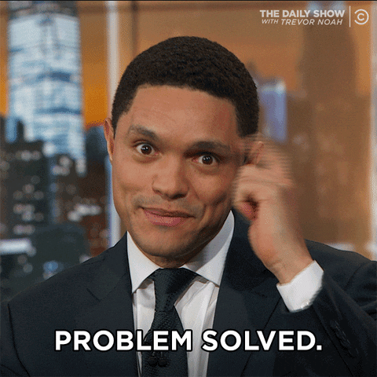
Do not warn supervisor, decline the offer
Pros
Most ethical solution
Maintain good relationship
No risk
Cons
Manager still loses his job
Lose a good opprtunity
Notes:
Alternative #4: Do not warn supervisor and decline the offer.
With this alternative, we take the most ethically correct route to solve this problem. The way we would accomplish this by letting everything work out naturally as it would if you were not aware of anything. We would not advise the supervisor about the information we had, and we would also not accept the job. This way we maintain a good relationship with the supervisor while also not risking our own position.
So why do we think it is a good idea. The reason we believe it is a good idea is because you as one of the main stakeholders involved, neither benefit nor lose anything. It is also the one of the more ethically correct solution that we have, WHERE we do not risk anything of our own.
Now an argument can be made, that we did not inform our manager and he might lose his job which can have a lot of negative impacts in his life, but to counter that, as a manager he has certain responsibilities that he must take care off and certain standards that he must meet. If he does not meet these requirements, then maybe he is not the best suited for the job.
We do have to keep in mind that if we choose to decline the position, the management may consider someone else for the position and you would miss a good the opportunity.
So, if you do choose to go with this solution, you have to ask yourself what your priorities are. If you really want the job and you are willing to risk your current position for that job, then this is not the best solution for you. However, if protecting your current position and continuing in the company without risking anything is priority, then this is the workable solution.

Slide 15

Final Evaluation
Notes:
Now lets get into the final evaluation

Slide 16
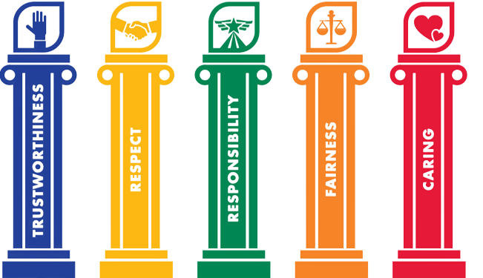
Pillars Of Character
Our Choice: Do not warn supervisor and decline the job offer
Most ethical choice
Covers most pillars of character
Demonstrates:
Responsibility
Trustworthiness
Respect
Caring
Justice and Fairness
Notes:
After careful review and analysis of all the case studies. We believe that the most ethical alternative is to not warn the supervisor and decline the offer from your supervisor's supervisor. To back this up, we look towards the ethical decision-making model. Specifically, the pillars of character. This alternative covers 5 out of the 6 pillars of character. The first two are responsibility and trustworthiness. You demonstrate this by not informing your supervisor about his supervisor’s concerns and going behind his back. By not accepting position you cover the other 3 pillars of character. You respect your colleagues and provide a fair and just opportunity for a hiring campaign. And finally, you show that you are caring for your supervisor by not agreeing to take his position without confronting him first.
To close this out, we want to reiterate that all alternatives mentioned are ethical depending on the perspective, however we think that out of all options. This alternative aligns with the most principles within the ethical decision-making model.

Slide 17

Thanks for listening!
Notes:
Thank you for listening to our presentation. If you have any questions, please let us know by typing in the chat or unmuting your mic. Sincerely, Caffeine Overflow!

